Slide 1
Nutriments prediction pipeline from Images

Slide 2
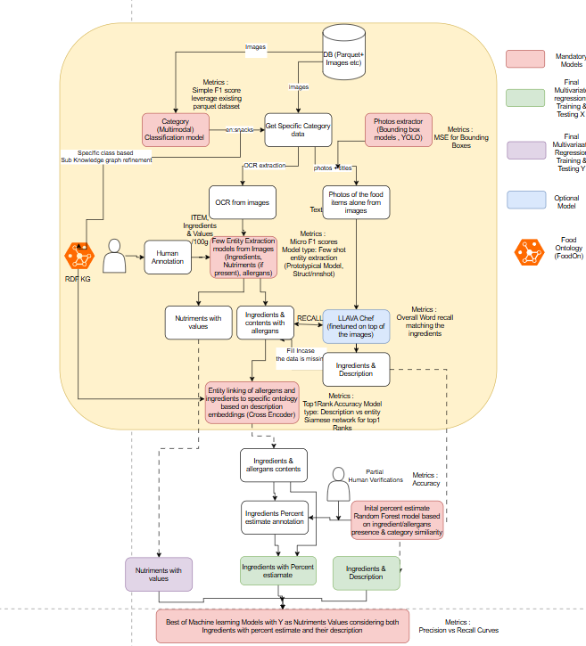
Solution Pipeline
Dataset :
Images from food items
Objectives :
As we need to predict the nutriment values from Images
Solution Pipeline Description
First we need to predict from Images the category : {snacks, plant foods} – Category classification Model
Then after OCR, get the Entities like Ingredients, Nutriments (if available) from the images – Entity extraction models. The ones available will be used for training to predict the missing ones (semi-supervised learning) and future inferences
Use the ingredients predicted to guide LLAVA Chef to predict/generate ingredients from Images where the data is not available.
Entity linking model of the extracted ingredients to map to tags like en: oil, en: sugar etc against existing ontology model
In some images, there are % percent estimate for each ingredient. Hence based on similiarity of the ingredients and statistical techniques, find the % percentage estimate for remaining data (semi-supervised learning)
Finally for datasets using the ingredients information extracted for available data using the above steps, the nutriments values can be estimated

